Slide 1

PYTHON PROGRAMMING UNIT III
Department of Computer Science and Engineering,
School of Computing
SATHYABAMA
Institute of Science and Technology
Deemed to be University
Chennai.

Slide 2
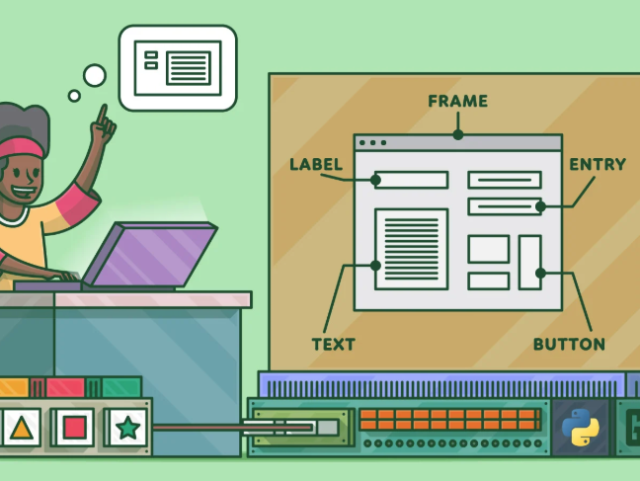
UNIT III GUI PROGRAMMING

Slide 3
SYLLABUS
Introduction to GUI library
Layout management
Events and bindings
Fonts
Colours
Canvas
Widgets (frame, label, button, check box, entry, listbox, message, radiobutton, text, spinbox).

Slide 4
Introduction to GUI
User can interact with an application through controls, and pictures.
User can perform the task just by clicking on relevant control.
Advantages:
It is user friendly
It adds attractions and beauty to any application by adding images, colors, menus, animation etc.
It is possible to simulate the real life applications.
GUI helps to create graphical components like button, radio button, menus, etc, and use them efficiently.

Slide 5
GUI - Tkinter Library
Tkinter is the standard GUI library for Python.
Python when combined with Tkinter provides a fast and easy way to create GUI applications.
Tkinter provides a powerful object-oriented interface to the Tk GUI toolkit.
Creating a GUI application using Tkinter is an easy task. All you need to do is perform the following steps −
Import the Tkinter module.
Create the GUI application main window.
Add one or more of the above-mentioned widgets to the GUI application.
Enter the main event loop to take action against each event triggered by the user.

Slide 6
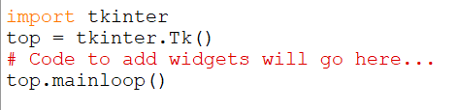
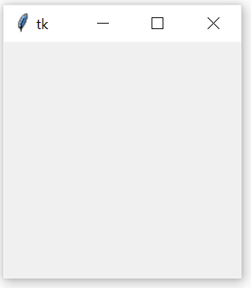
The Root Window
To display the graphical output, the space we create is known as “Root window”
Output
Tk() – to create the window
Mainloop()-
to take action against each event triggered by the user.

Slide 7
Working with Containers
It is a component used as a place where drawings or widgets can be displayed.
It is a space that displays the output to the user.
Types:
Canvas
Frame

Slide 8
Canvas
It is a container that is generally used to draw shapes like lines, curves, arcs and circles.
To Create Canvas:
C=canvas(root,bg=“blue”,height=300, width=300,cursor=“pencil”)
root- main window
bg= background color
Height, width- window widtha nd height
Cursor- Shape of the cursor
Once the canvas is created , it should be added to the root window
c.pack()

Slide 9
Drawing Shapes
To create a line: create_line()
To create a oval:create_oval()
To create a Rectangle: create_rectangle()
To Create a text : create_text()
To Create an arc: create_arc()
To create a image: create_image()
To create a Polygon: create_polygon()

Slide 10
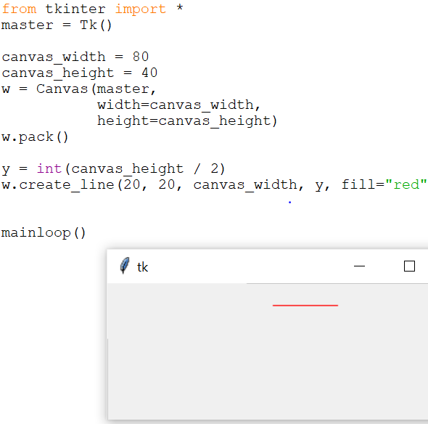
create_line()
Syntax: The method create_line(coords, options) is used to draw a straight line.
The coordinates "coords" are given as four integer numbers: x₁, y₁, x₂, y₂ .
This means that the line goes from the point (x₁, y₁) to the point (x₂, y₂).

Slide 11

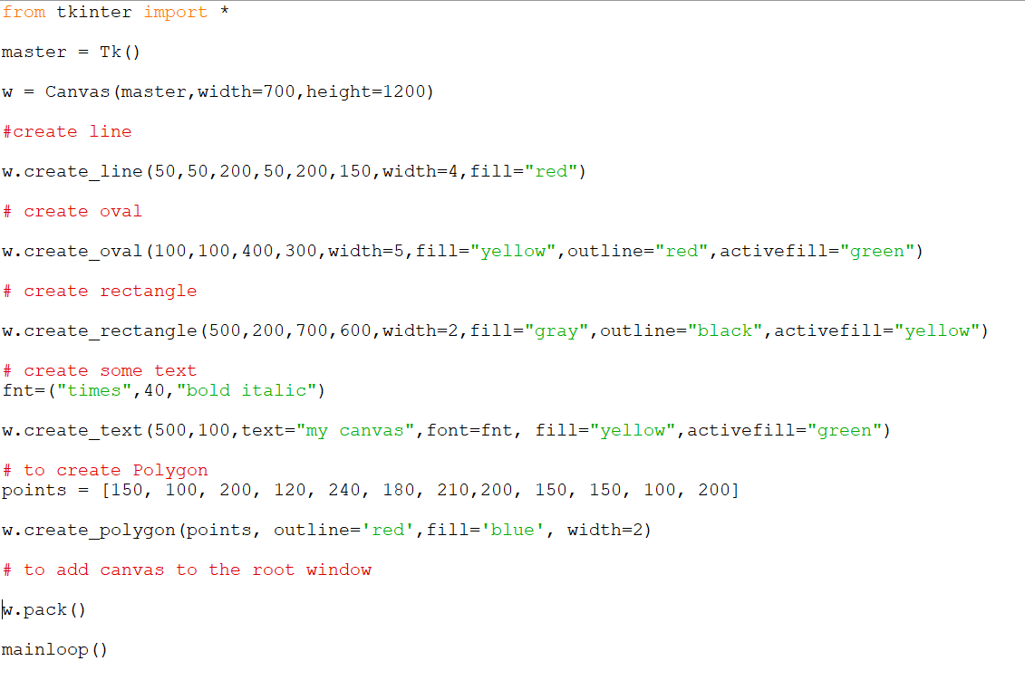

Slide 12
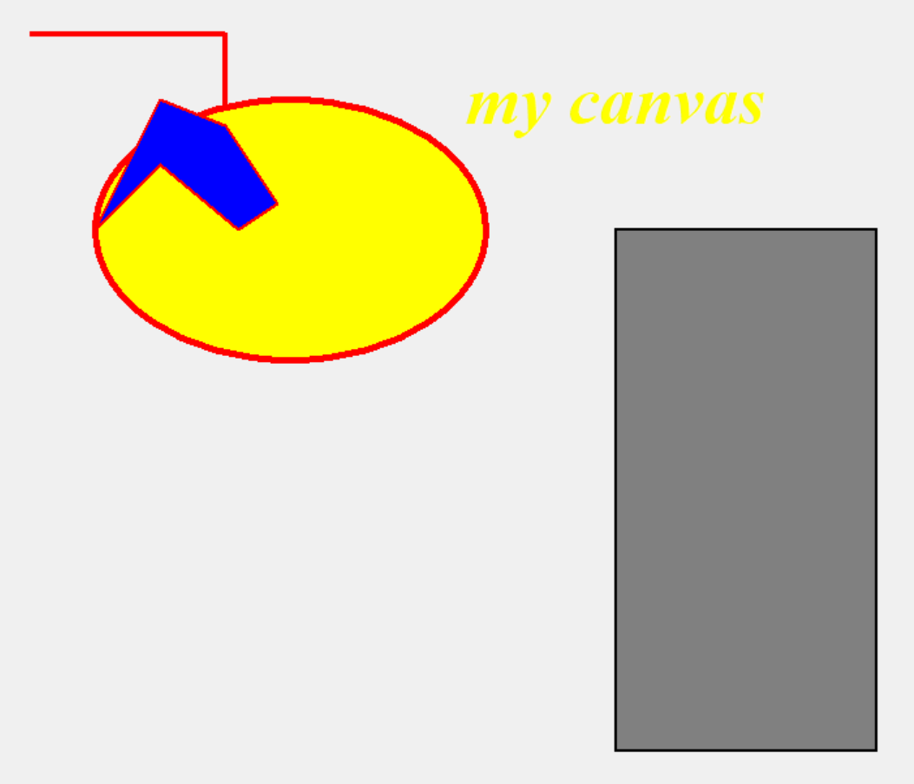
Output

Slide 13
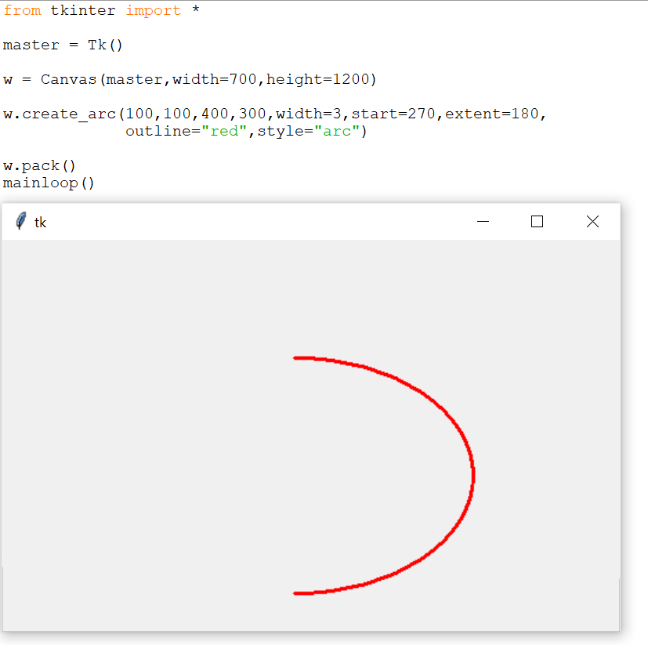
Example- using arc

Slide 14
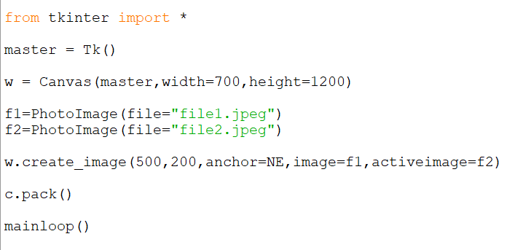
To Display Image
Load the image :
file=PhotoImage(file=“cat.gif”)
Create Image

Slide 15
Attributes
bg- Background Color
Fill – fill color
Outline- outline color
Activefill – color to be filled when the mouse is placed
Font – to set the font
Start – arc start angle
Extent – arc drawn from start angle to extent angle
Style -arc/pie slice/ chord
Anchor – position in the window to place the image. (N,NE,NW,S,SE,SW,W,E,CENTER)

Slide 16
Fonts and Colors
Font- a type of displaying letters and numbers.
Syntax:
f= (font name, size, style)
Color:
Name of the color can be used to fetch the color.

Slide 17
Frame
It is a container that is generally used to display widgets like buttons, label, checkbox,menus etc.
Create Frame:
f=Frame(root, height, width, gb, cursor)
To add frame to the root window
f.pack()

Slide 18
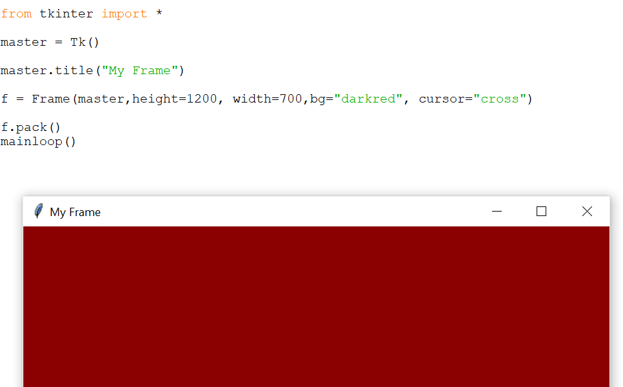
Creation of Frame

Slide 19
Widgets- GUI Controls
A widget is a GUI component that is displayed on the screen and can perform a task as desired by the user.
Create widgets as objects
Label
Button
Message
Text
Checkbutton
Radiobutton
Entry
Listbox
Spinbox

Slide 20
Label
A label represents constant text that is displayed in the frame or container.
A label can display one or more lines of text that cannot be modified
Syntax:
lb=Label(Root, options)

Slide 21
S.No. | Option & Description
1 | Activebackground:Background color when the button is under the cursor.
2 | Activeforeground:Foreground color when the button is under the cursor.
3 | Bd:Border width in pixels. Default is 2.
4 | Bg:Normal background color.
5 | Fg:Normal foreground (text) color.
6 | Font:Text font to be used for the button's label.
7 | Height:Height of the button in text lines (for textual buttons) or pixels (for images).
8 | Highlightcolor:The color of the focus highlight when the widget has focus.
9 | Image:Image to be displayed on the button (instead of text).
10 | Width:Width of the button in letters (if displaying text) or pixels (if displaying an image).

Slide 22
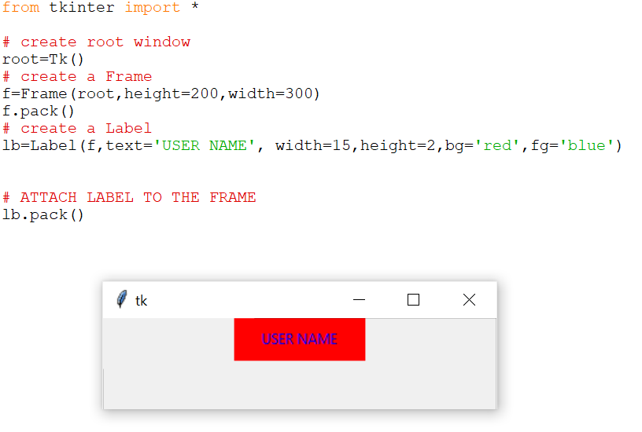
Example:

Slide 23
Button
These buttons can display text or images that convey the purpose of the buttons.
You can attach a function or a method to a button which is called automatically when you click the button.
Syntax:
Parameters
master − This represents the parent window.
options −These options can be used as key-value pairs separated by commas .

Slide 24
S.No. | Option & Description
1 | Activebackground:Background color when the button is under the cursor.
2 | Activeforeground:Foreground color when the button is under the cursor.
3 | Bd:Border width in pixels. Default is 2.
4 | Bg:Normal background color.
5 | Command:Function or method to be called when the button is clicked.
6 | Fg:Normal foreground (text) color.
7 | Font:Text font to be used for the button's label.
8 | Height:Height of the button in text lines (for textual buttons) or pixels (for images).
9 | Highlightcolor:The color of the focus highlight when the widget has focus.
10 | Image:Image to be displayed on the button (instead of text).
11 | Width:Width of the button in letters (if displaying text) or pixels (if displaying an image).

Slide 25
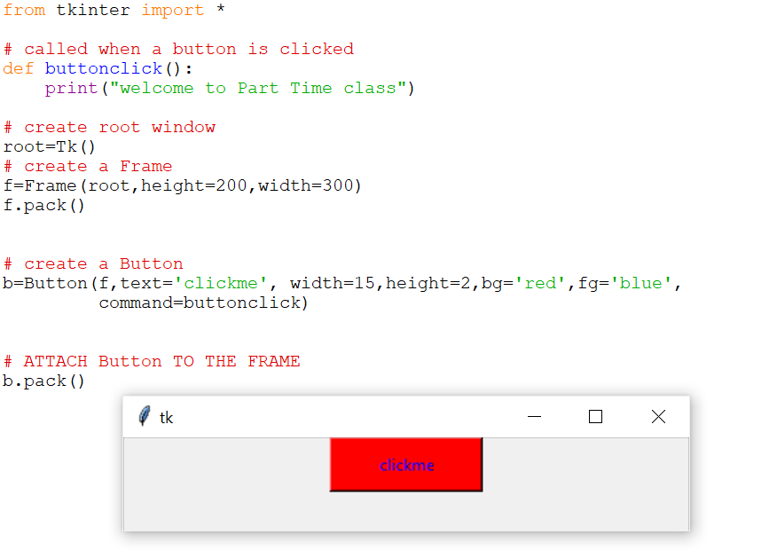
Example

Slide 26
Message
It is similar to label. Used to display multiple lines of text where as a label is used to display a single line of text.
Syntax:
m=Message(Root,option….)

Slide 27
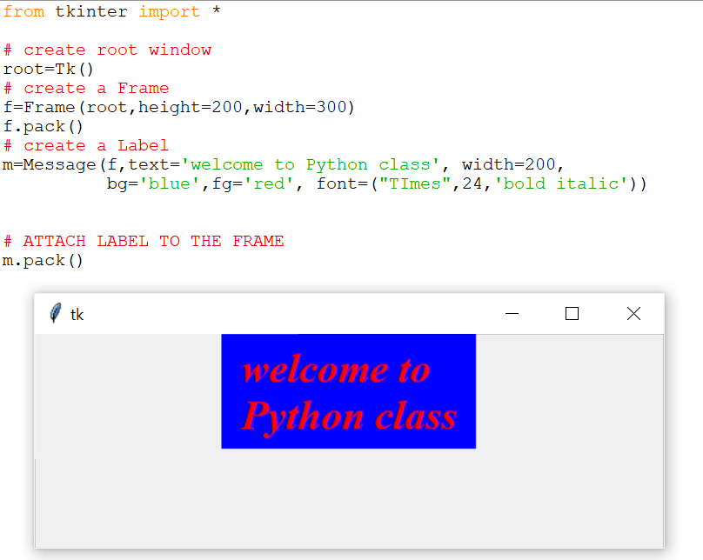
Example

Slide 28
Text Widget
It has several options and can display multiple lines of text in different colors and fonts.
It is possible to insert text, modify text or delete it.
Display Images on in the Text widget.
Syntax:
T=Text( root, options…..)
Methods: insert(), create_image(), tag_add(), configure()

Slide 29
S.No. | Option & Description
1 | Activebackground:Background color when the button is under the cursor.
2 | Activeforeground:Foreground color when the button is under the cursor.
3 | Bd:Border width in pixels. Default is 2.
4 | Bg:Normal background color.
5 | Fg:Normal foreground (text) color.
6 | Font:Text font to be used for the button's label.
7 | Height:Height of the button in text lines (for textual buttons) or pixels (for images).
8 | Highlightcolor:The color of the focus highlight when the widget has focus.
9 | Image:Image to be displayed on the button (instead of text).
10 | Width:Width of the button in letters (if displaying text) or pixels (if displaying an image).
11 | Wrap: where to cut the line, CHAR,WORD,NONE

Slide 30
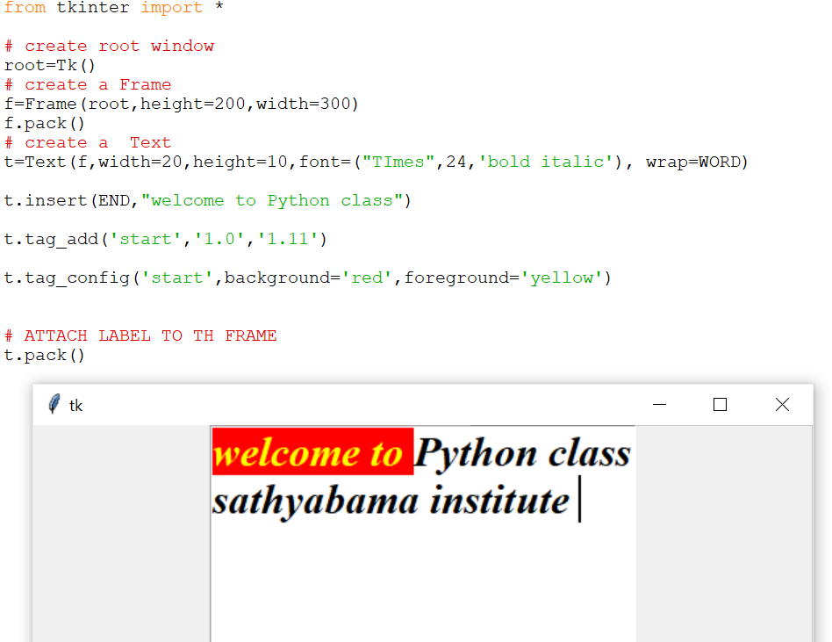
Example

Slide 31
Checkbutton
Useful for the user to select one or more options from the available group of options.
Syntax:
c=Checkbutton(root, option..)
Methods:
IntVar() – to know the state of the check box, whether clicked or not

Slide 32
S.No. | Option & Description
1 | offvalue Normally, a checkbutton's associated control variable will be set to 0 when it is cleared (off). You can supply an alternate value for the off state by setting offvalue to that value.
2 | onvalue: Normally, a checkbutton's associated control variable will be set to 1 when it is set (on). You can supply an alternate value for the on state by setting onvalue to that value.
3 | Bg:Normal background color.
4 | Fg:Normal foreground (text) color.
5 | Font:Text font to be used for the button's label.
6 | Height:Height of the button in text lines (for textual buttons) or pixels (for images).
7 | Highlightcolor:The color of the focus highlight when the widget has focus.
8 | Image:Image to be displayed on the button (instead of text).
9 | Width:Width of the button in letters (if displaying text) or pixels (if displaying an image).

Slide 33
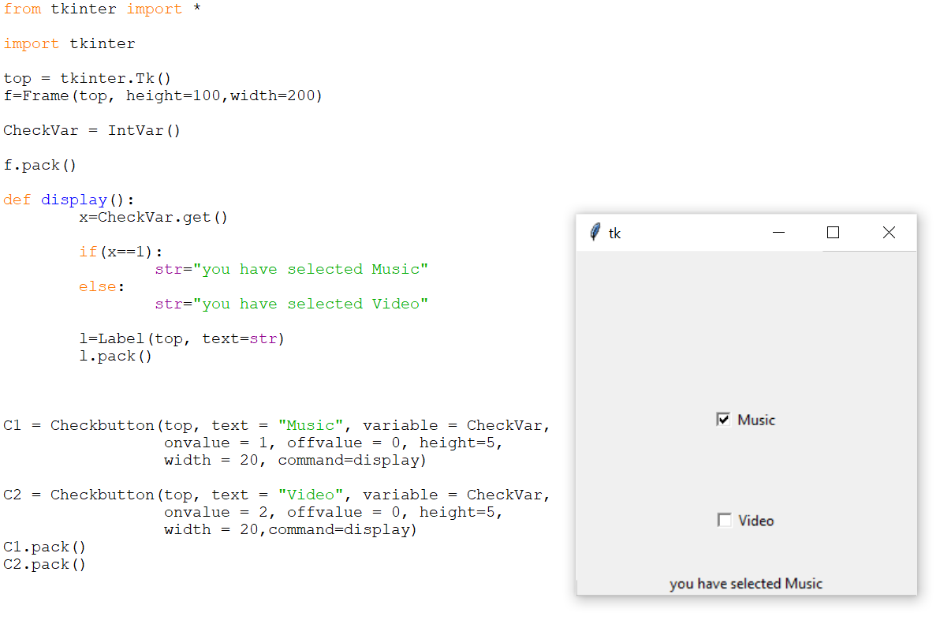
Example

Slide 34
Radiobutton
Similar to check box, but useful to select only one option from a group of available options.
Syntax:
R=Radiobutton(root,option)

Slide 35
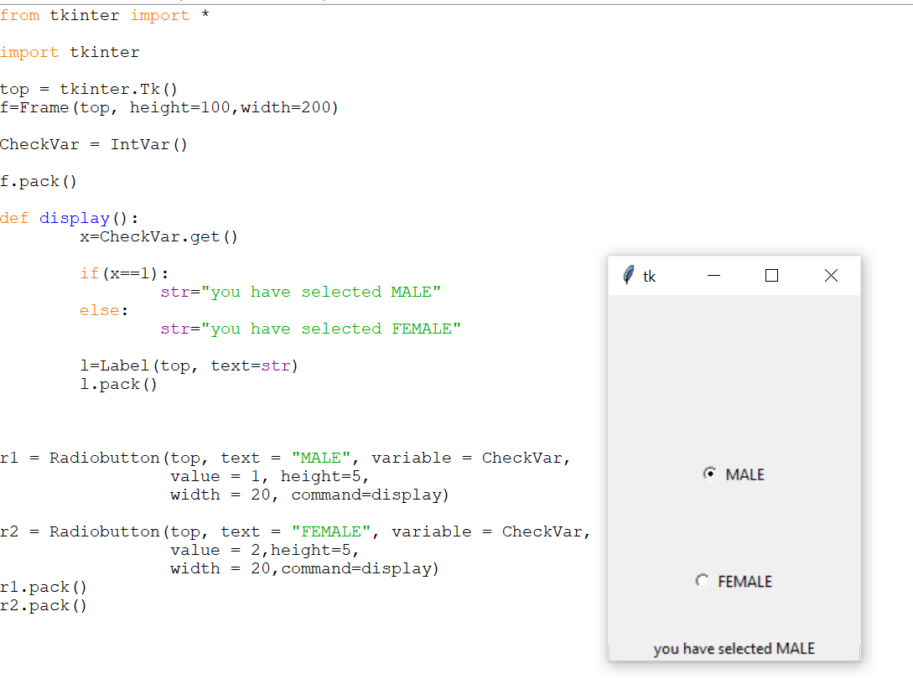
Example

Slide 36
Entry-Control
Used to enter or display a line of text.
In GUI to read input values from user it is used.
Syntax:
e=Entry(root, option)
Options:
show – to hide the character

Slide 37
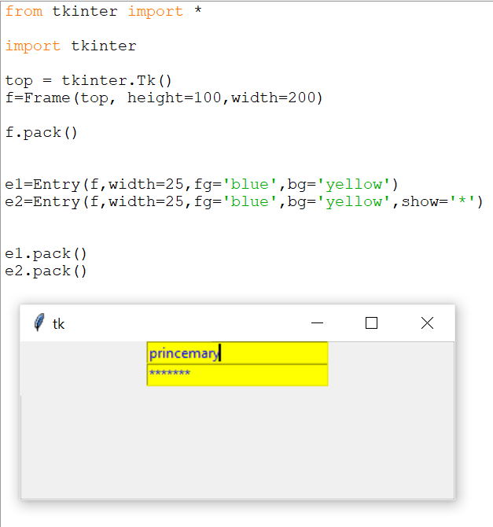
Example

Slide 38
Listbox
To display a list of items in a box, so that user can select one or more items.
Syntax:
L=Listbox(root, option)
Option:
activestyle- underline/dotbox/none
Selectmode- BROWSE/SINGLE/MULTIPLE/EXTENDED
Methods:
lb.insert(index,item name) # to insert item to listbox

Slide 39
bind()
To add a function when some item is selected from the list box.
Syntax:
Lb.bind(‘<<ListboxSelect>>’,method name)
Example:
lb.bind(‘<<ListboxSelect>>’, on_select)

Slide 40
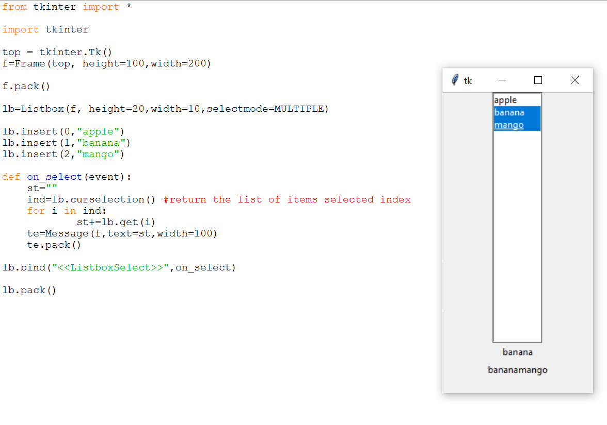
Example

Slide 41
Spinbox
Allows user to select a value form a set of values
Set of values may be in a range of numbers or a fixed set of strings.
Syntax:
s=Spinbox(root,options)
Example:
S=Spinbox( f, from_=5,to=15,textvariable=val1)

Slide 42
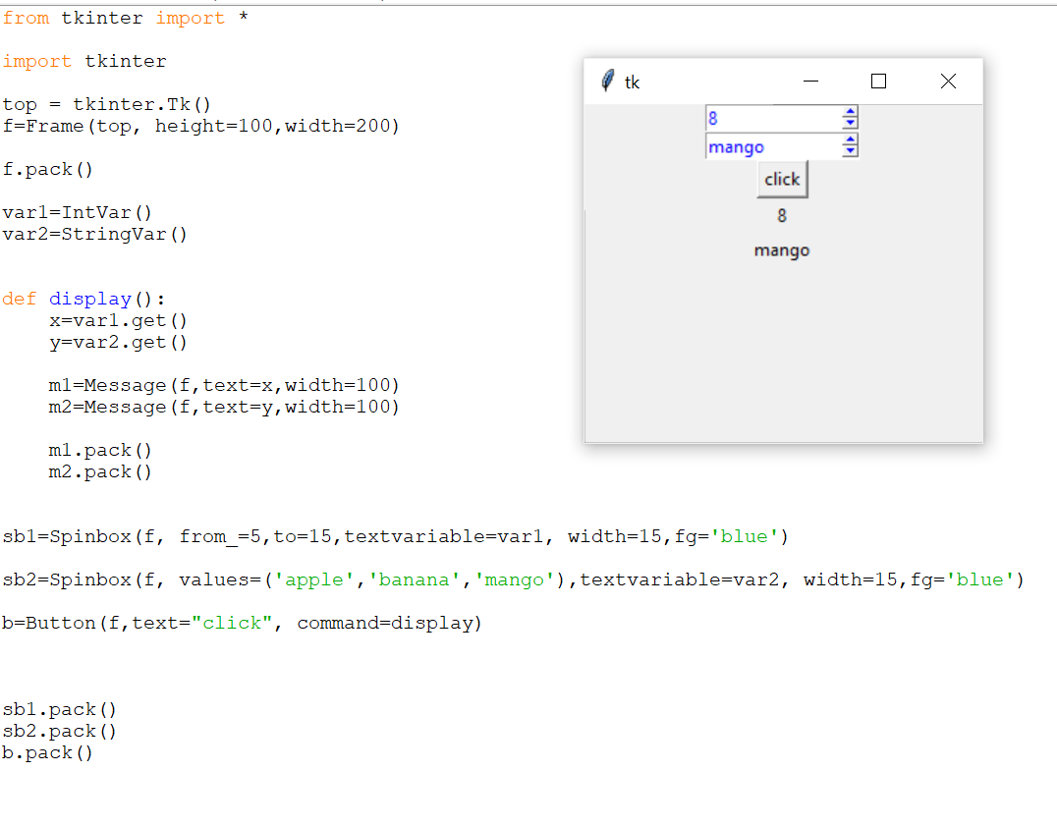
Example

Slide 43
Layout Management
To arrange the widgets in the frame is called Layout Management.
Types:
Pack Layout Manager
Grid Layout Manager
Place Layout Manager
Arranging widgets on the screen includes determining the size and position of components.
Widgets can provide size and alignment information to geometry managers, but the geometry managers has always the final say on the positioning and sizing

Slide 44
Pack Layout Manager
Pack is the easiest to use of the three geometry managers of Tk and Tkinter.
Instead of having to declare precisely where a widget should appear on the display screen.
we can declare the positions of widgets with the pack command relative to each other.
Syntax:
Controlobject.Pack(option)

Slide 45
Pack- Options
fill = X/Y/BOTH/NONE
padx ,pady-> how much space should be left around the component horizontally and vertically.
ipadx,ipady ->how much space should be left around the text horizontally and vertically.
side= LEFT /RIGHT

Slide 46
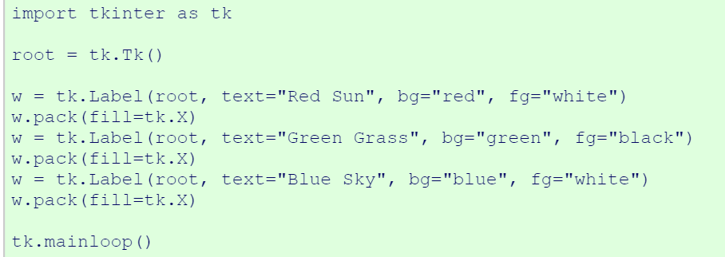
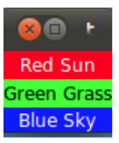
Example- fill option

Slide 47
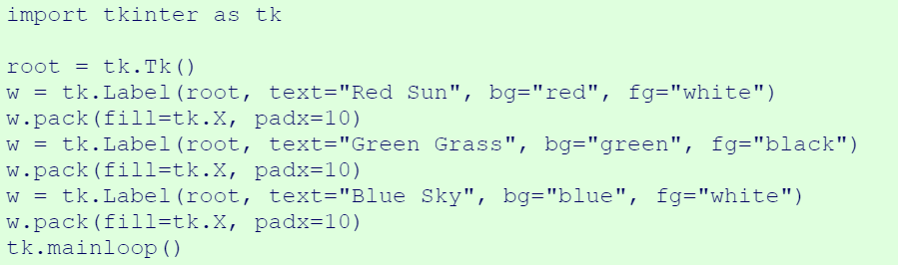
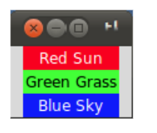
Padding - option

Slide 48
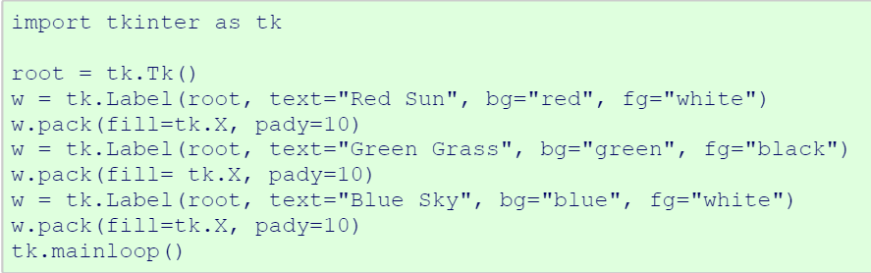
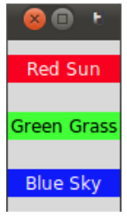

Slide 49
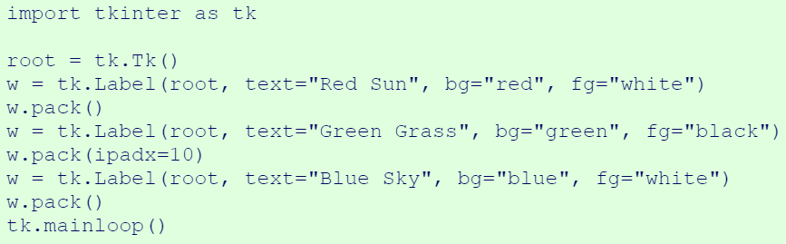
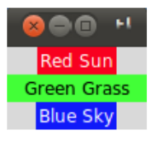

Slide 50
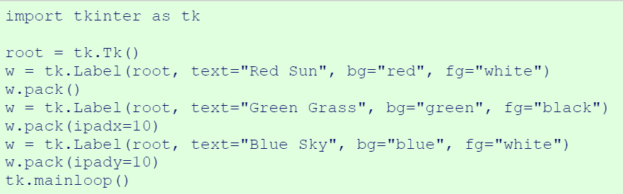
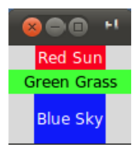

Slide 51
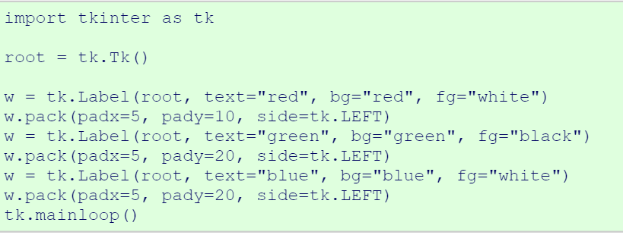
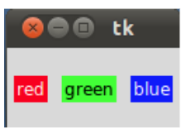
Side -Option

Slide 52
Place Layout Manager
The Place geometry manager allows you explicitly set the position and size of a window, either in absolute terms, or relative to another window.
The place manager can be accessed through the place method.
It can be applied to all standard widgets.
Syntax: place(x,y,width,height)
X,Y-> position to display
Width, height of the control

Slide 53
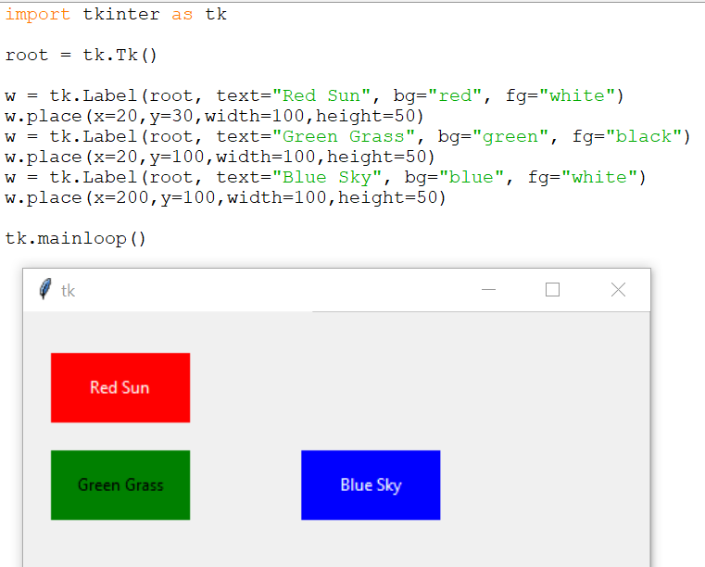
Example

Slide 54
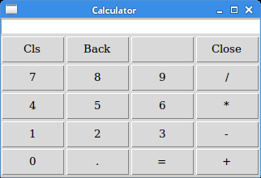
Grid Layout Manager
The Grid geometry manager places the widgets in a 2-dimensional table, which consists of a number of rows and columns.
The position of a widget is defined by a row and a column number.
Widgets with the same column number and different row numbers will be above or below each other.
Syntax: gride(row,column,padx,pady)
Row,column -> position of the grid

Slide 55
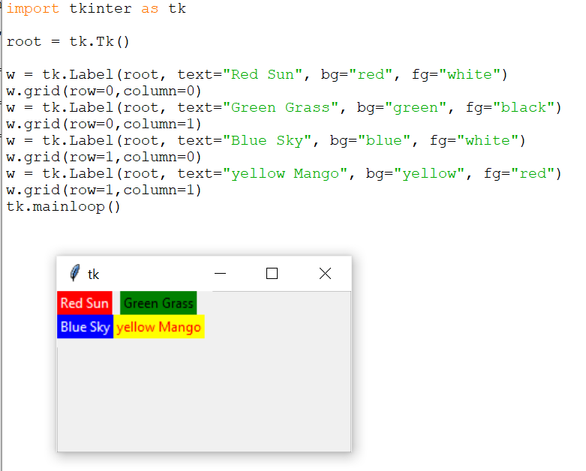
Example

Slide 56
Events and Bindings
Tkinter provides a mechanism to let the programmer deal with events.
For each widget, it's possible to bind Python functions and methods to an event.
Syntax: widget.bind(event, handler) If the defined event occurs in the widget,
the "handler" function is called with an event object.

Slide 57
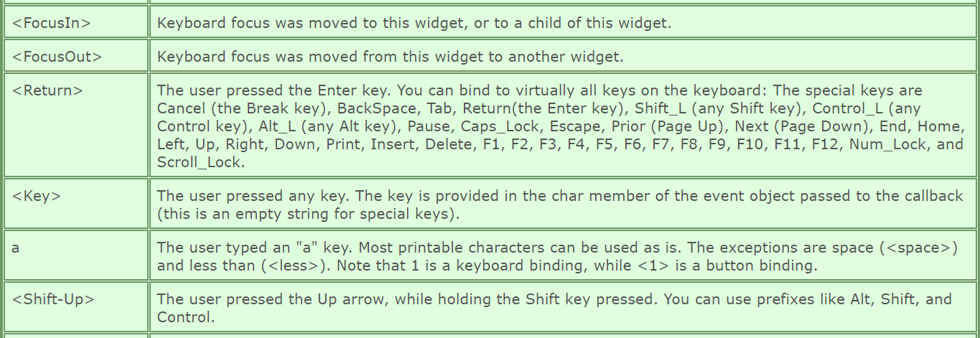
Keyboard Event Handling

Slide 58
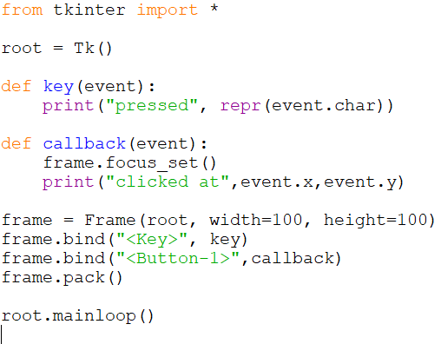
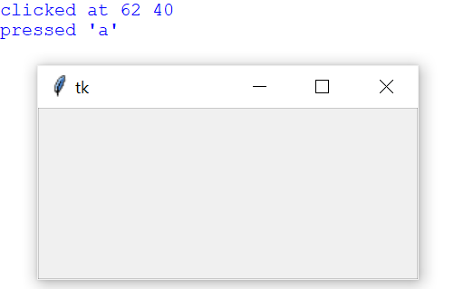
Capturing keyboard events

Slide 59
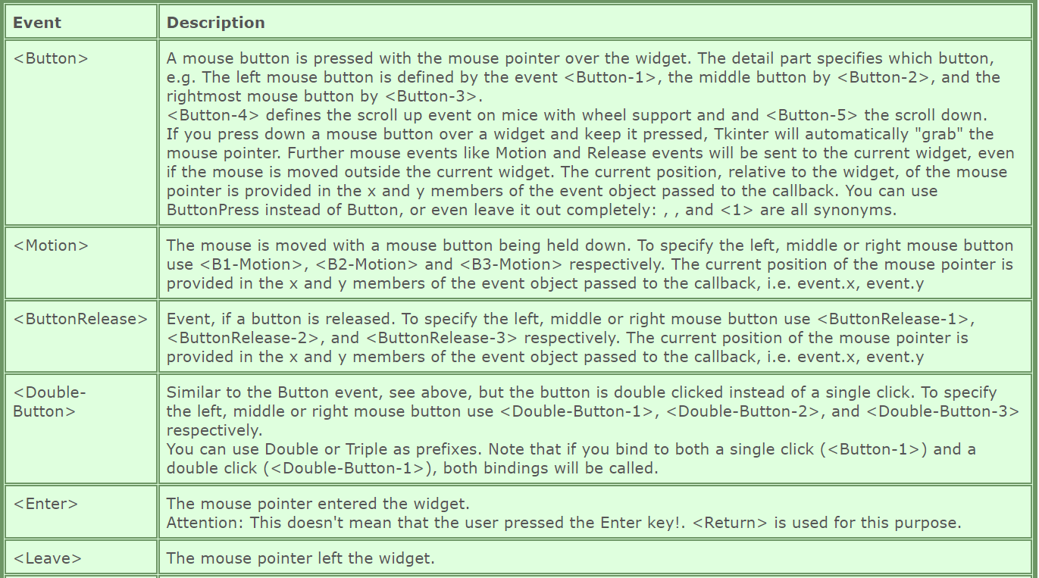
Mouse Event Handling

Slide 60
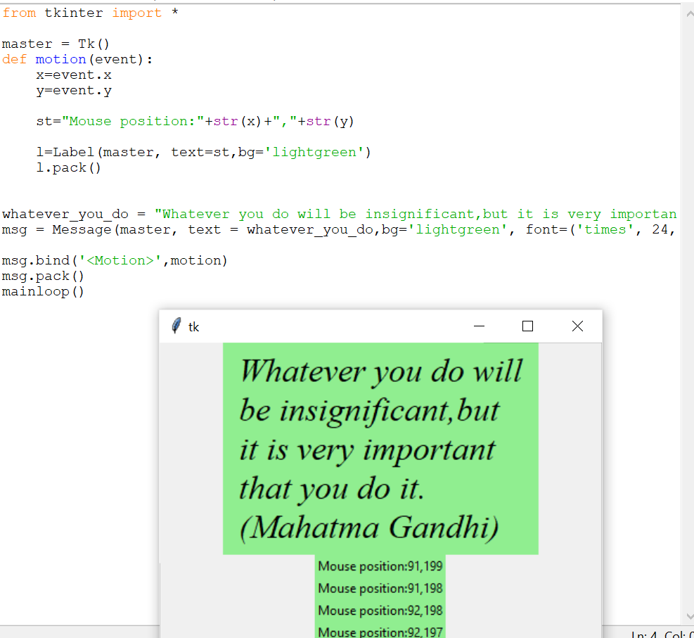
Example

Slide 61
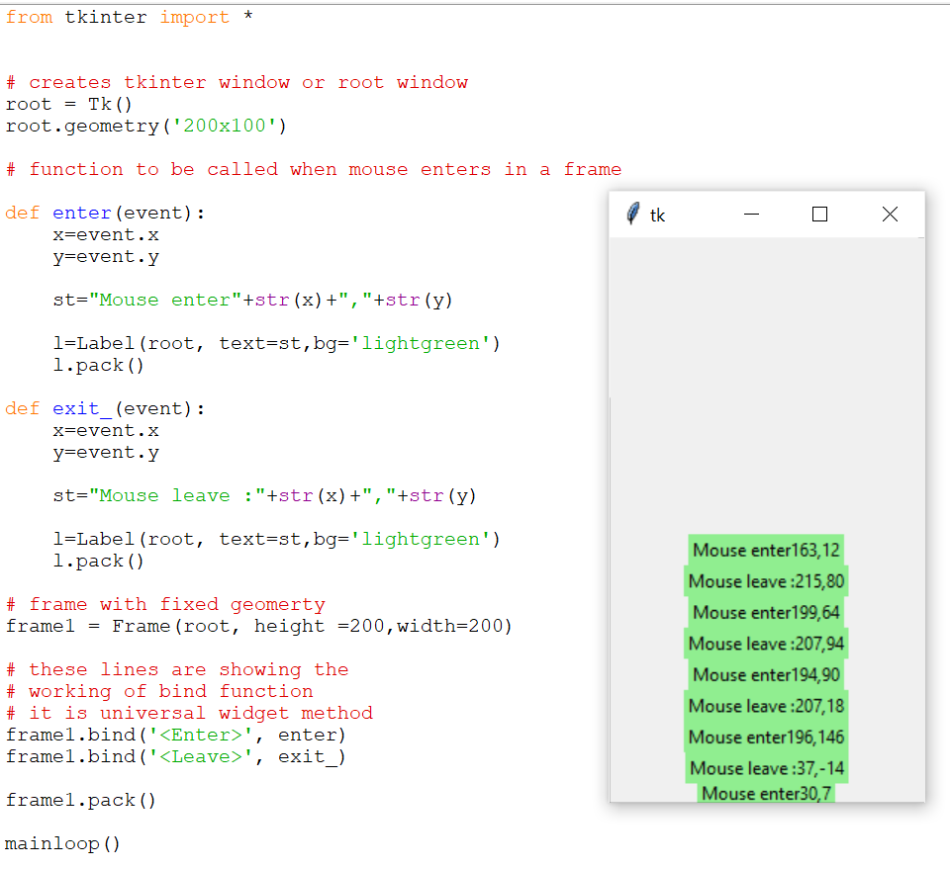
Example

Slide 62
Questions
1.Write the Python Program to create simple window.
2. Write a Python Program to create label, entry and button components and arrange the components using Grid Layout.
3. Write a Python Program to validate username and password.
4. Write a Python Program to display the basic shapes.
5.Write the GUI program to create List Box for shopping cart.
6. Write a python Program to create simple calculator.
7. Write a Python Program to add image on the button.
8. Write a Python program to create simple application form.
9. Write a Python program to create check button for selecting multiple hobbies.

Slide 63
Write a Python Program to validate username and password.
Validation :
At least 1 letter between [a-z] and 1 letter between [A-Z].
At least 1 number between [0-9].
At least 1 character from [$#@].
Minimum length 6 characters.
Maximum length 16 characters.

Slide 64
Program

